Slide 1
Grocery Shop automation system
Name : Shyam G. Pradhan
Reg No : 2018bcs509
Roll No : A76

Slide 2
Information gathering (surveys)
How grocery shop sells their products?
How they manage stock information?
Did they used online way to sell their products during pandemic?
How they manage their inventory?
What are the problems they had faced during pandemic?

Slide 3
Basic Idea
Is to make system which will help small grocery shop to move their business on internet.
Is to make ecommerce web app which solve problems in managing and selling products.
Is to make grocery shop more efficient ( Smart inventory, using graphical figures).
Future proof

Slide 4
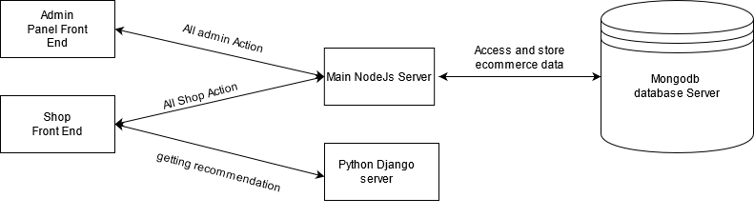
Conceptual diagram

Slide 5
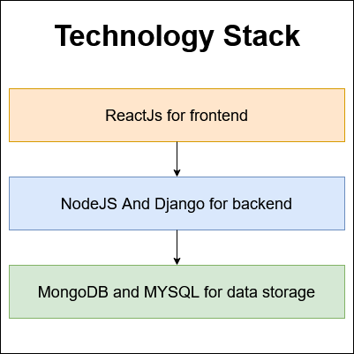
technology stack for project

Slide 6
Modules
There two main modules of this project :
Admin Panel : Admin means shop owner who will perform all shop management operations and manage ecommerce site.
Customer’s Panel : Customer/s can perform ecommerce function

Slide 7
Admin Panel
Following are some sub modules in Admin Panel :
Product management : for managing product (Adding, listing and Editing the product)
Order management : for managing orders (Accepting and rejecting orders)
Delivery management : for delivery management
Inventory management : for inventory management (Stock availability, Adding Stock)

Slide 8
Customer’s panel
Following are some functionalities that can be performed by this,
Product List (Category wise)
Recommendation of products (on basis of product category that customer choose)
Cart Management
Account management
Order management (Order Status, Listing of Orders )
Profile management (Address Management, Password management)

Slide 9
Demo

Slide 10
Future Scope
These modules can be added in the project in future,
Online Payments
Notification module
Smart inventory management through Machine learning algorithm
Improving Recommendation system
Improving UI/UX

Slide 11
Conclusion
The main reason behind making this project is to make the system to start the local grocery shop online.
In this internet era not only big enterprises but small local grocery shop should be online.
This project might be solution to transform local grocery shops into ecommerce thing.

Slide 12
Thank you!

